Slide 1
Secure data hiding in images using steganography
CAPSTONE PROJECT
Presented By: Shubhangi Verma
Student Name : Shubhangi Verma
College Name & Department : Rajiv Academy for Technology and Management & MCA Department

Slide 2
OUTLINE
Problem Statement
Technology used
Wow factor
End users
Result
Conclusion
Git-hub Link

Slide 3
Problem Statement
To hide data from Malicious Insiders through Steganography, and to understand the use of Steganography for sending confidential information to users so that they can protect the data from an Intruder and thus Decrypt it whenever used.

Slide 4
Technology used
Platform:
Python IDLE
Libraries:
OpenCV: For image processing and manipulation.
NumPy: For handling and manipulating image arrays.
PIL (Pillow): For image handling and operations.
Cryptography: For encrypting and securing the hidden messages
Device Specification
Minimum RAM -6GB
Processor – Pentium and above

Slide 5
Wow factors
Uses steganography to embed a message into an image without noticeable changes.
User-friendly GUI for easy encryption and decryption.
Lossless data hiding using pixel value manipulation instead of traditional cryptographic techniques.
Works on any standard image file format (PNG recommended for best results).

Slide 6
End users
Individuals: Seeking privacy for personal communications.
Journalists and Whistleblowers: Sharing sensitive information securely.
Corporations: Protecting confidential data and intellectual property.
Government Agencies: Ensuring secure communication and protecting national security.
Digital Forensics Experts: Investigating cybercrimes and safeguarding digital evidence.

Slide 7
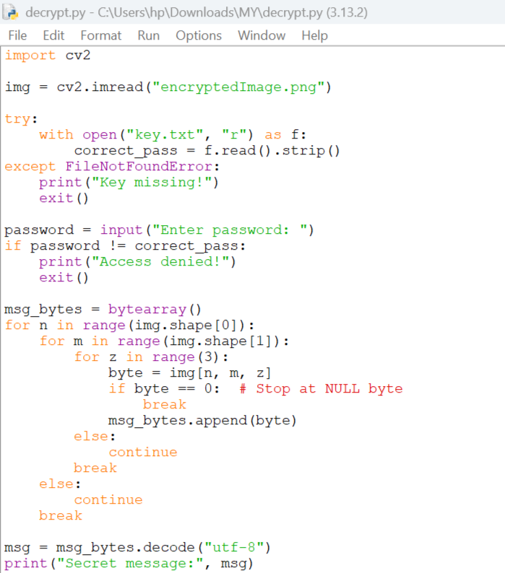
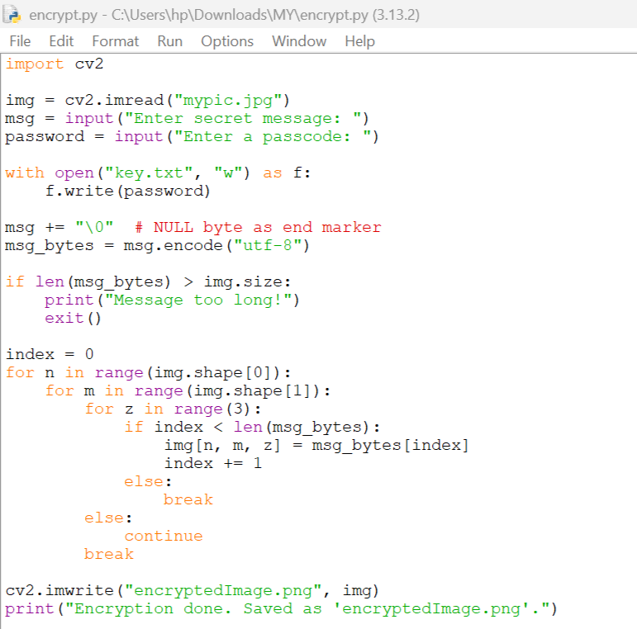
Results

Slide 8
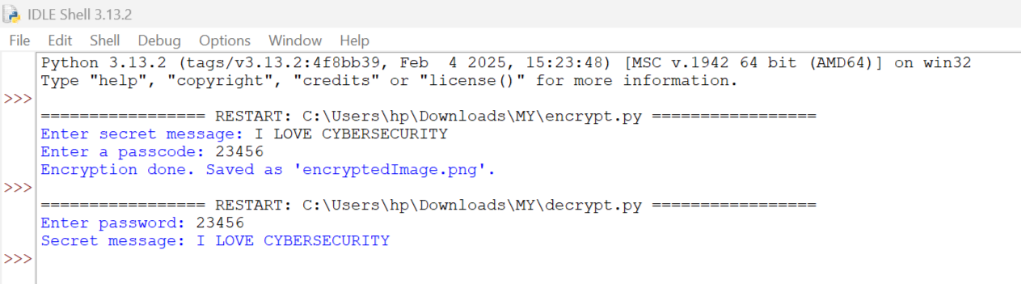
Results

Slide 9
Conclusion
This project demonstrates the effective use of steganography to securely hide and retrieve messages within digital images. By utilizing Python and libraries like OpenCV, NumPy, and PIL, we ensure that sensitive information can be transmitted without detection. This method enhances data privacy and security, making it valuable for personal, corporate, and governmental communications.

Slide 10
GitHub Link
https://github.com/shubhangi3333/Cybersecurity.git

Slide 11
THANK YOU

